Slide 1
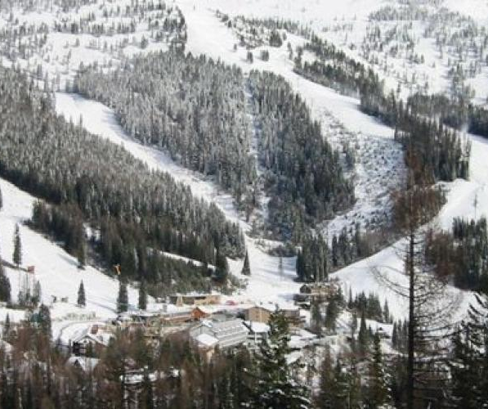
Bringing Big Data to Big Mountain Resort
Ka Hung Lee

Slide 2
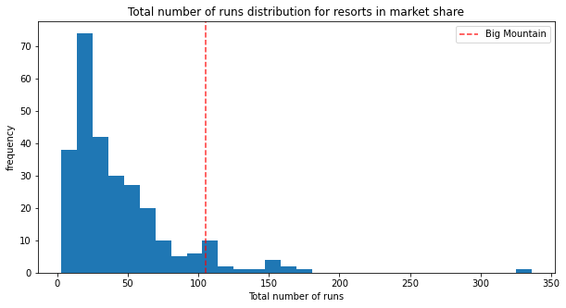
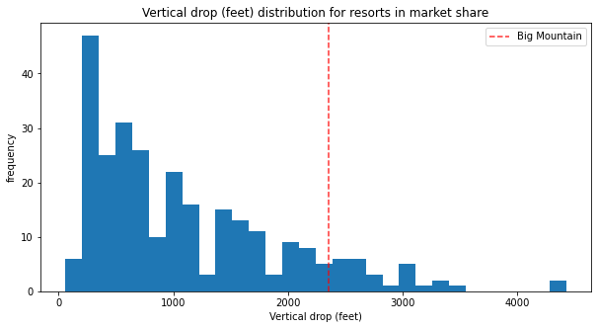
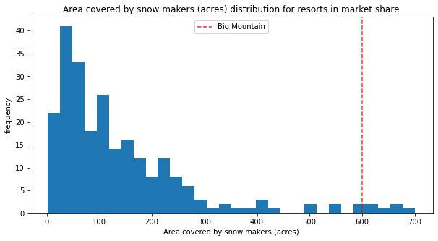
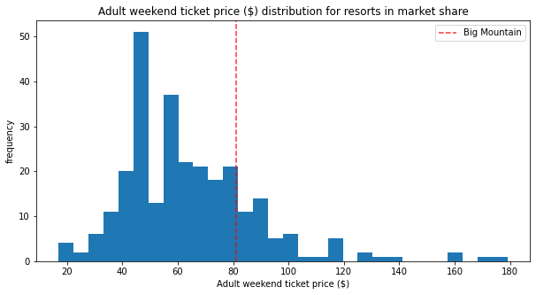
Missing Profits?
Big Mountain Resort has some of the best features in the market!
2353 feet vertical drop!
105 trails!
Despite its generous accommodations and facilities, the resort’s existing strategy relies on national averages for ticket prices
Leadership desires a data-driven approach for new ticket prices
600 acres of guarentee snow!
But above average ticket prices??

Slide 3
Potential Scenarios
1. Permanently shut down up to 10 of the least used runs
2. Increase the vertical drop by adding a run to a point 150 feet lower down and installing of an additional chair lift to bring skiers back up
3. Same as #2, but add 2 more acres of snow making cover
4. Increase the longest run by 0.2 mile with 4 acres of additional snow making cover

Slide 4
Recommendations
1. Permanently shut down up to 10 of the least used runs
2. Increase the vertical drop by adding a run to a point 150 feet lower down and installing of an additional chair lift to bring skiers back up
3. Same as #2, but add 2 more acres of snow making cover
4. Increase the longest run by 0.2 mile with 4 acres of additional snow making cover

Slide 5
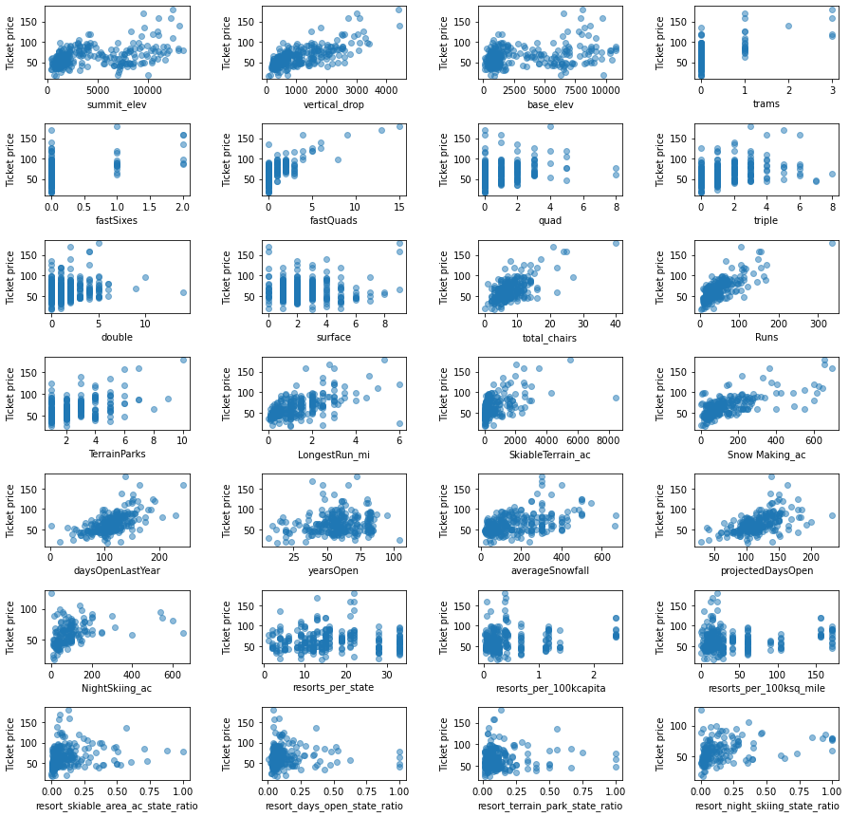
Notable Trends in our Data

Slide 6
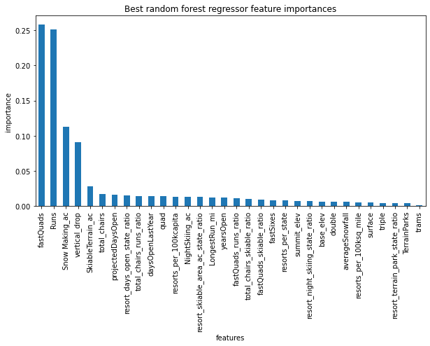
Price Model: Random Forest
Notable trends are weighed heavily in our model
Current Ticket Price for Big Mountain Resort: $81.00
Model’s Predicted Price: $95.87
Model’s Mean Absolute Error: $10.39
Model’s Predicted Price with Max Error: $85.48
(existing price is undervalued)

Slide 7
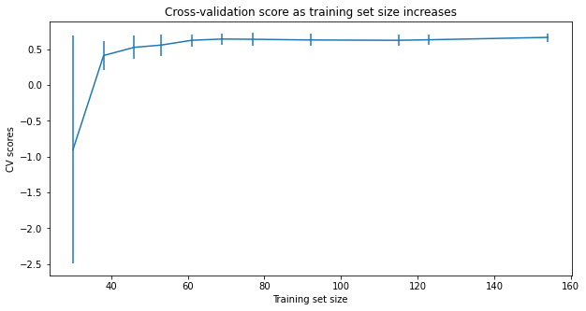
Model got enough data? Yes!
No notable improvement beyond a sample size of 60

Slide 8
Model Results: Best Cases
1. No change in ticket price for closing down 1 trail, save up to $1.54 million in operating costs
2. $1.99 increase in ticket price for new trail and lift, ~$2 million in profit ($3.47 million in added revenue, up to $1.54 million in operating costs for new lift)
3. Same as #2, but with additional costs for the 2 extra acre of snow making cover
4. No change in ticket price for the expanded features, added additional cost for additional snow making cover

Slide 9
Summary
Based on our model, the current ticket price is undervalued
The model suggests Scenario 2 as the most profitable of 4 options the leadership team were considering
  This scenario should include an increased ticket price of $82.99
However, leadership team could consider to use the model’s original predicted price of $95.87 (or $85.48 when they consider the amount of error in the model) without any changes to the resort

